Slide 1


SAP UI5 & FIORI with OData TRAINING using BAS
Shekhar Vedi
Day – 7

Slide 2

Agenda – Day 7
Steps to create XML Model
Resource Model
Concept of BaseController
Formatter
How to create a formatter
Using the predefined Formatter Classes
User Experience V/S User Interface
UI5 vs Fiori
What is Fiori?
Introduction to List controls in SAP UI5
Types of List in UI5
Creating model in Manifest.json
Search Functionality
List Modes and Grouping
Header and Footer Toolbar
Worklist Application
Split App Container
Loading Empty view at Start
Performance Issues in our app

Slide 3
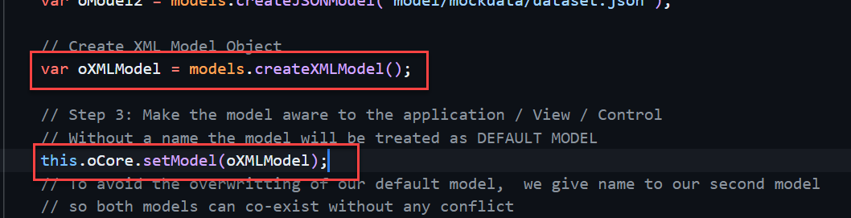
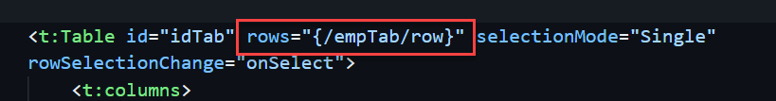
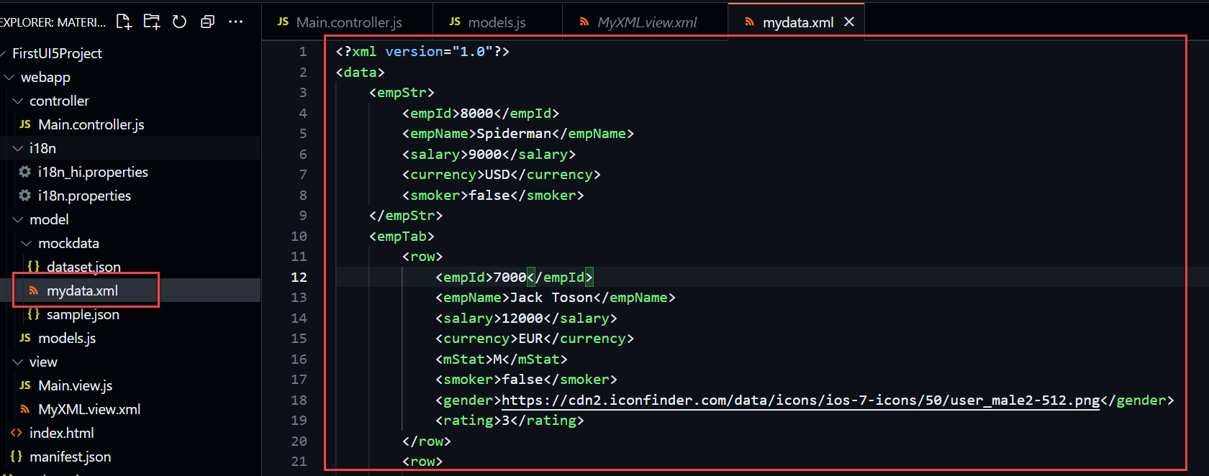
Hands – on: XML Model
The XML model allows to bind controls to XML data. It is a client-side model intended for small data sets, which are completely available on the client. The XML model does not contain mechanisms for server-based paging or loading of deltas. It supports two-way binding.
Code Links:
mydata.xml
models.js
Main.controller.js
MyXML.view.xml

Slide 4
Resource Model
We build software for international audience, we cannot just hardcode every screen element in English, if it requires multi-lingual support, we need to add resource model.
i18n → Internationalization : Make the app available for international usage, which means supporting multiple languages.
There are 2 job roles in the process:
UI5 Consultant
Language Expert KM
?sap-ui-language=hi
Implement the model to provide support for internationalization
Translate the texts to provide support in multiple languages
I18n.properties
TEXTS
Language specific

Slide 5
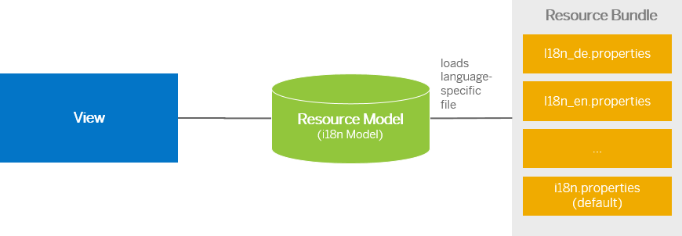
Steps to Create a Resource Model
Create resource bundle which includes label field
Create a folder i18n and inside this folder the file named i18n.properties for default labels.
And i18n_langcode.properties for different languages
Set The model
For more information about i18n you check the link
https://openui5.hana.ondemand.com/1.34.9/docs/guide/831039835e7c4da3a8a0b49567573afe.html
We can change the language of the app by adding ?sap-language=language_code at the end of the URL of the app. Example for Hindi we will write ?sap-language=hi

Slide 6
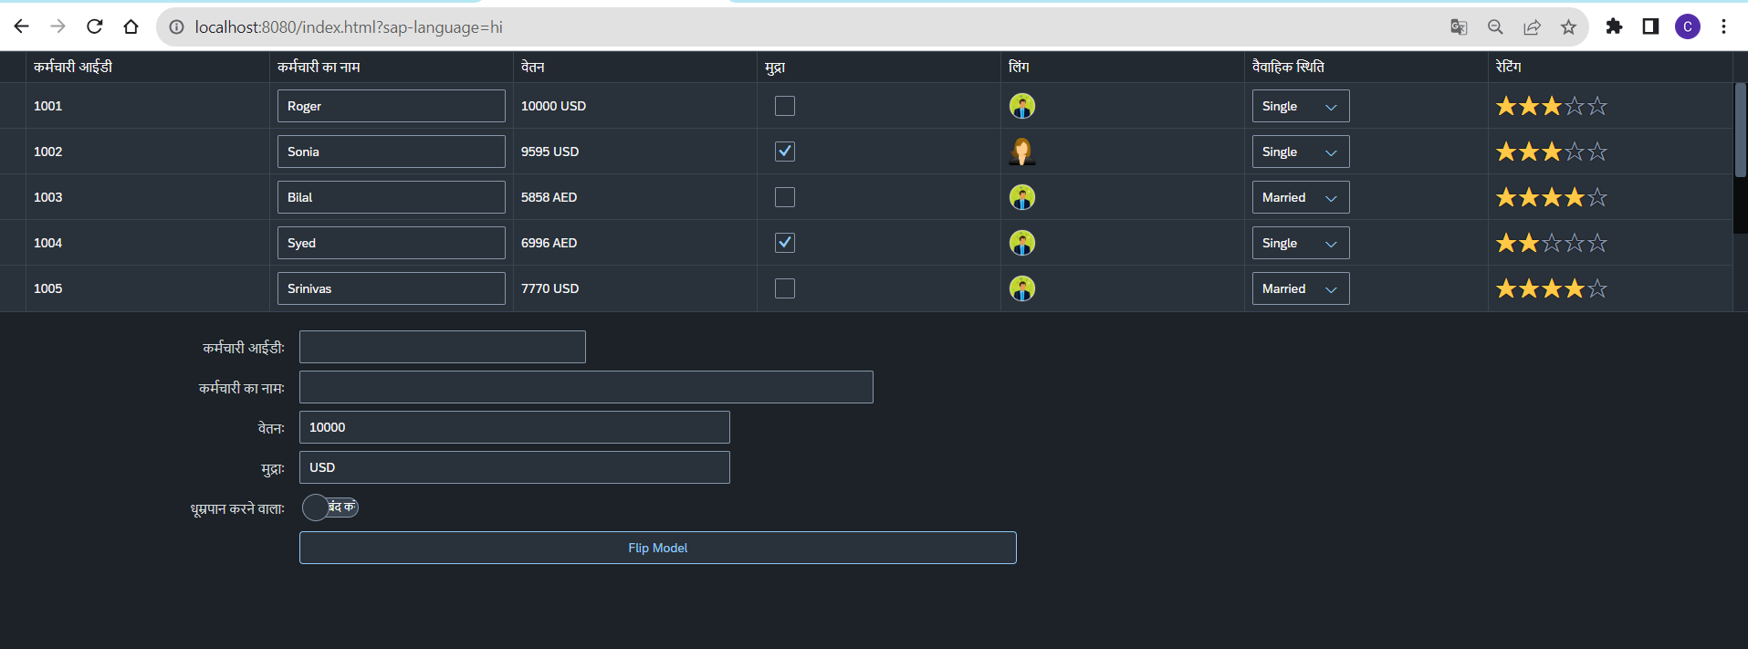
Hands – on: Resource Model
Now we will see how the language of an app is changed using the i18n file.
We have to create a folder ‘i18n’ in webapps folder and in the folder, we have to add files named ‘i18n.properties’ and one another file named according to the language we want. For example:- for Hindi language the file is named as ‘i18n_hi.properties.
Code Links:-
MyXML.view.xml
Main.controller.js
models.js
i18n.properties
i18n_hi.properties

Slide 7
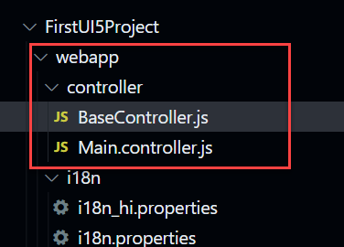
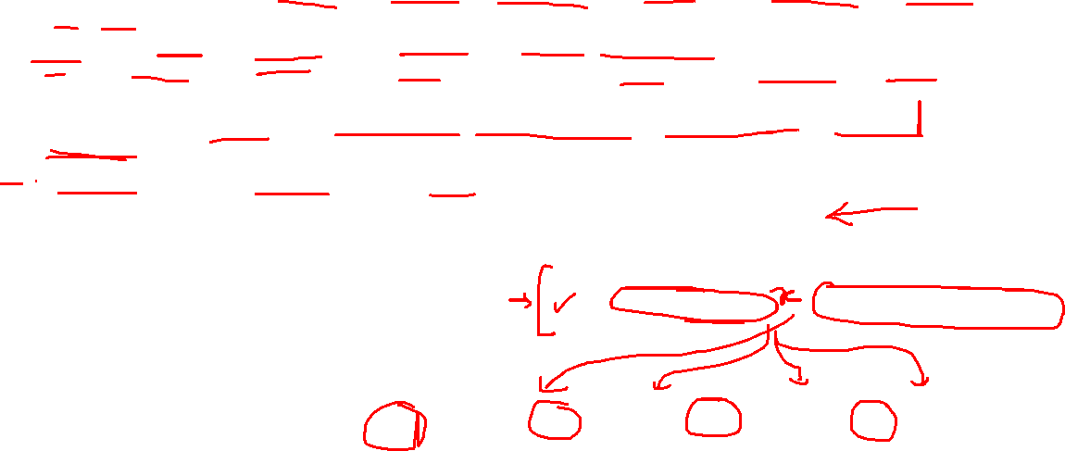
Concept of Base Controller
Base Controller:- A base controller is a controller with basic functionalities from which the other controllers in your SAPUI5 application inherit.
The base controller holds basic functionalities that are used across multiple controllers.
The base controller itself is just another JavaScript file and it does not have the .controller prefix. Just BaseController.js and not BaseController.controller.js.
We can use base controller to write all the reusable function and can also declare the global variables to use them across all the controllers.
The base controller goes in the controller folder in your SAPUI5 application folder structure:
sap/ui/core/mvc/Controller
BaseController
x becomes truly global
x
Controller 1
x
Controller 2
x
Controller 3
x
Controller 4
View 1
View 2
View 3
View 4

Slide 8
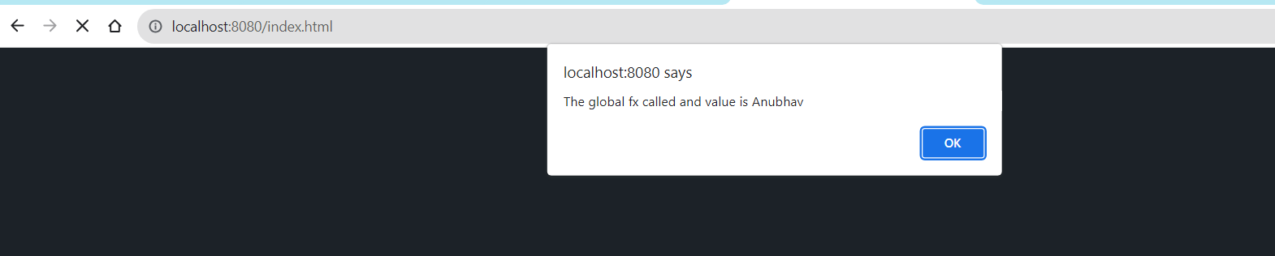
Hands – on: Base Controller
Now we will create a base controller and create a reusable function in it.
We will use that reusable function in our main controller.
Code Link:
BaseController.js
Main.controller.js

Slide 9
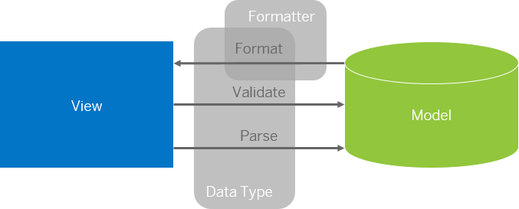
Formatter in SAP UI5
Formatters are used to define the formatting of data on the UI while data types work in both directions: they format the data on the UI and parse and validate user input that is entered.
Formatter is a function; This function gets called JUST Before the binding takes place with the view.
Formatter file is placed in a folder in webapp folder, and the file can be named anything with the .js extension.

Slide 10
How formatter works
Use Case: We want to display the name of the employee in Upper case to do we have to approaches
Changing all the employee name in the file.
This approach is time consuming, high maintenance and not practical in case of very large data.
Using a formatter function to convert the employee name in upper case at runtime.
In this approach we will use a reusable function which will convert the name in upper case at run time
This approach is low maintenance, and we don’t have to worry about the output as it will be handled inside the function.
Binding Syntax of the formatter:
propertyName=“{path: ‘pathName’, formatter: ‘.formatterFunctionName’}”
Working of the formatter:
Value at the path will be passed as a Input parameter in the formatter function
propertyName=“{path: ‘pathName’, formatter: ‘.formatterFunctionName’}”
Output value from formatter function will be passed to the property

Slide 11
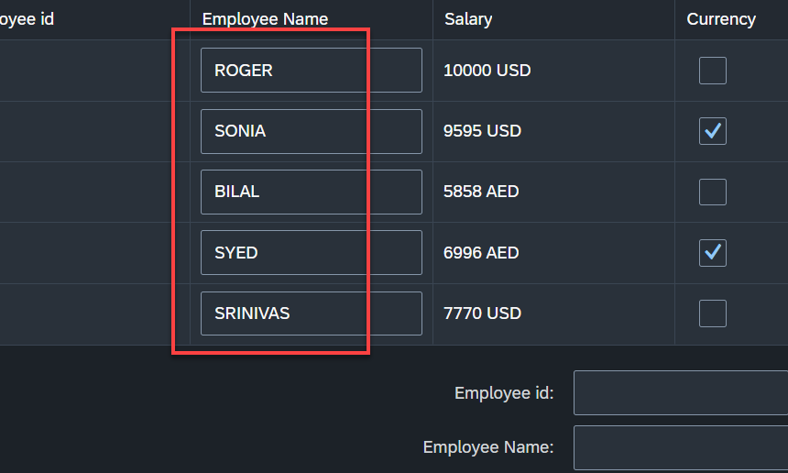
Hands – on: Formatter
Now Create a formatter to format the employee name in table to uppercase.
Code links:-
MyXML.view.xml
Main.controller.js

Slide 12
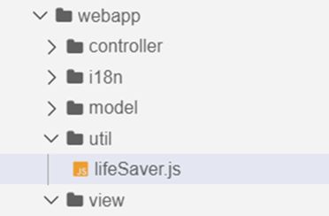
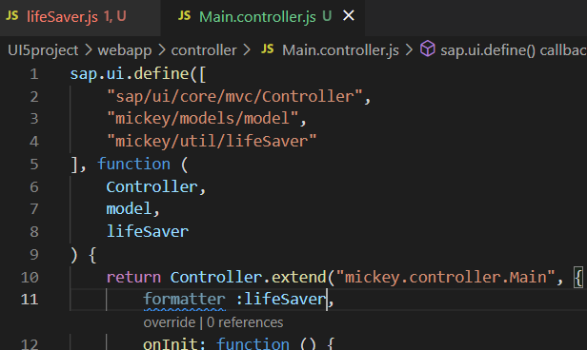
How to modularize formatter
To modularize a formatter first create a utils or util folder inside the webapp folder.
Now create a file lifesaver.js (you can give any name) inside the util folder .
Inside the file (lifeSaver.js) create the function(convertUC) for formatting.
After creating this function , inside the controller include it as a dependency and create a global variable at controller level which is accessible in the current view.
Now bind the formatter inside the view by using the second property binding syntax.
{path: ‘ ’ , formatter : ‘.formatter.formatterFunction’}
Formatter
The first dot represent that the it is in the controller

Slide 13
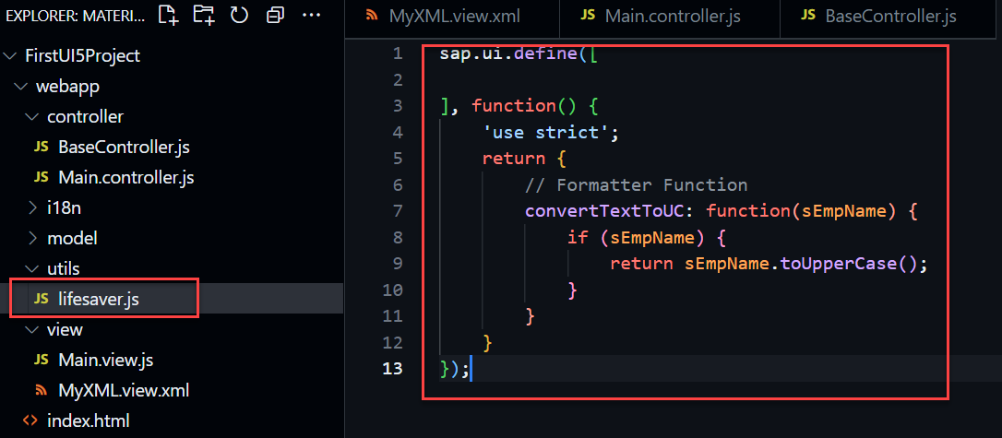
Hands – on: Modularize Formatter
Now we will modularize our formatter code by creating a new reusable JavaScript file for the formatter.
There will be no change on our current output.
Code links:-
MyXML.view.xml
Main.controller.js
BaseController.js
lifesaver.js

Slide 14
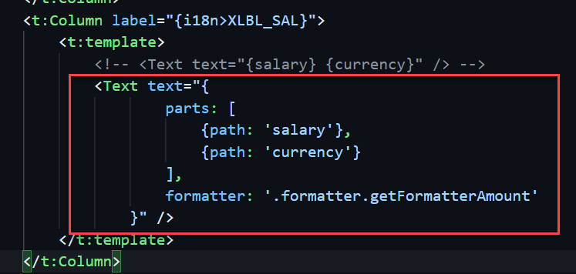
How to apply formatter for multiple path
When we there are two fields bind in one
for e.g:
Here we have to bind in a little different format and the format will be
“{ parts : [{path : ‘salary’},{path : ‘currency’}] , formatter : 'formatter.formatterfunction’ }”

Slide 15
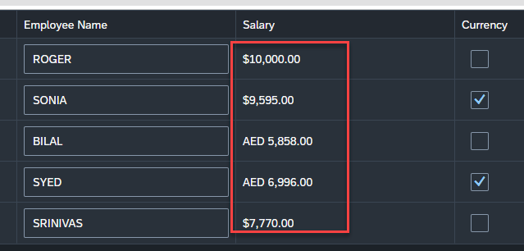
Hands – on: Currency Formatter
Now we will format the currency amount for the employee salary.
We will format the number according to the currency and also display the currency symbol.
Code links:-
MyXML.view.xml
lifesaver.js

Slide 16
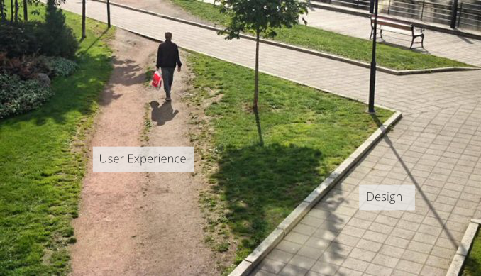
User Experience v/s User Interface
UI stands for user interface but UX stands for User Experience
UI is technical view point of our application interface which will be used to take and provide information to the user but UX is psychological and emotions of the app.
We can change the UI but we cannot change UX
Take an example of modern world of apps, where no one needs to give you training to use amazon, uber, eBay etc.
User interface is developer oriented. This is purely technical. We can change UI any number of times.
User experience is user oriented. It is psychological. We cannot change UX.

Slide 17
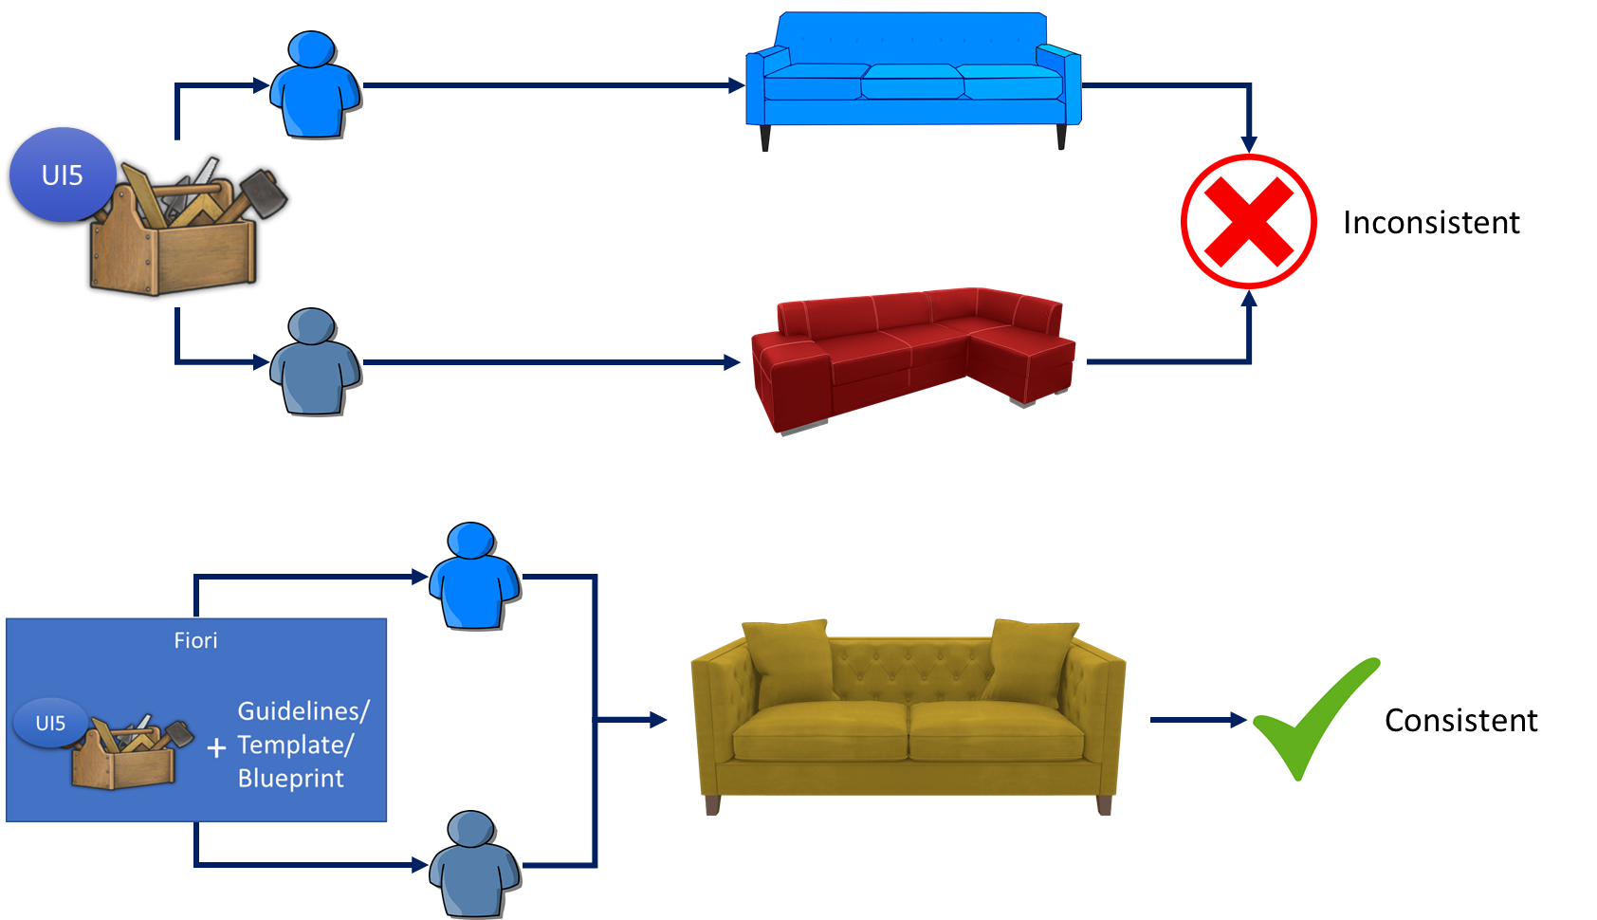
UI5 V/S Fiori
SAPUI5 is used to design UI but SAP Fiori is used to create User experience. Fiori apps are technically built on SAP UI5 only but they follow guidelines which are provided by sap and proven golden path for development of apps.
SAP Fiori provides also the pre-defined templates like master details, object list page, worklist etc. which brings our UI more closer to User experience.

Slide 18
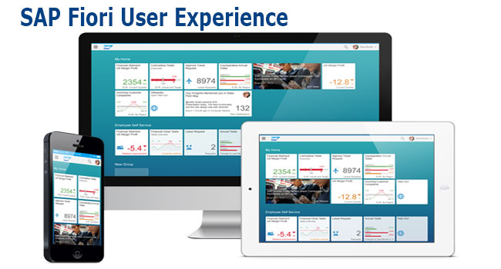
What is Fiori?
SAP Fiori is the user interface or user experience (UX) that supplements and can replace the SAP GUI. This streamlined application uses tiles to encapsulate standard tasks, such as approving purchase requisitions, viewing sales orders, and approving timesheets.
Fiori is SAP’s new user experience. These are standard apps delivered by SAP and by following the Development guidelines any one can use UI5 to create Fiori Apps.
Fiori is a streamlined application, delivering a role-based user experience that can be personalized across all lines of business, tasks and devices.
It uses tiles to encapsulate standard tasks like viewing sales orders or approving timesheets.
Fiori = UI5 + Development/Design Guidelines

Slide 19
Structure of a Fiori App
There are different folders and directory are required for setup project: webapp, Controller, models, utils ,view, Component.js, manifest.json, index.html
Structure of normal ui5 application
Index.html
View
Controller
Structure of Fiori Application
Dev.
sap/ui/core/UIComponent
Index.html
Root View
App.view.xml
Component.js
View 1
Controller 1
Container
App (pages)
View 2
Controller 2
manifest.json
App descriptor
App.controller.js
BaseController
Component.js is starting point

Slide 20
Component.js File
Component.js the starting point of all Fiori applications, it is used by Fiori Launchpad to kick-start our app. If an app has Component.js inside, it called Fiori like app.
We will decouple everything from index.html to avoid user starring app w/o launchpad because of security rick of user opening app direct from index file.
It is the wrapper of all the functionality.
The name of the file must be, must be Component.js
It should ideally be created inside the webapp folder
If our app does not have Component.js, we will not be able to integrate our app with launchpad
It is a class which inherits from sap/ui/core/UIComponent standard class. We inherit to reuse the functionality offered by SAP like routing.
When app starts, UI5 framework will scan your project’s base directory to check if it has a file with exact name Component.js
The component file calls the manifest file, and we keep all app level configuration inside the manifest file.

Slide 21
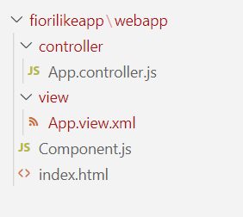
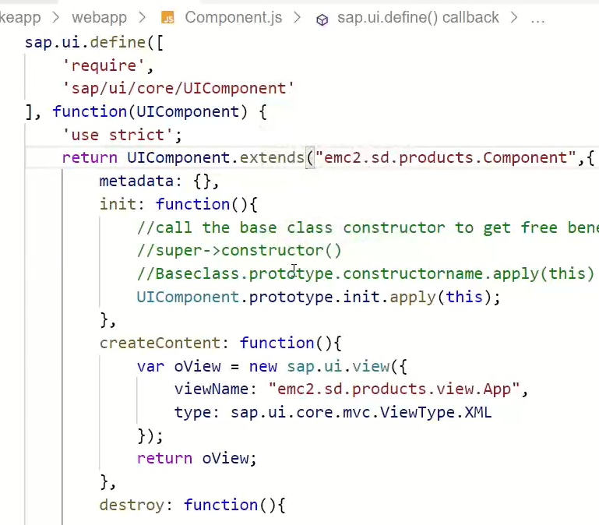
Hands – on: Create our first Fiori Like app
Create a new folder named fiorilikeapp in our projects directory, using the command mkdir fiorilikeapp.
Now navigate to the newly created folder using the command cd fiorilikeapp, and then create a webapp folder inside this newly created folder using the command mkdir webapp. Then move inside this folder using command cd webapp.
Now create two files in the webapp folder using the commands touch index.html and touch Component.js
After this create a App view and App controller in the respective view folder and controller folder.
Once the files are created paste the code from below links.
Code links:
index.html
Component.js
App.view.xml
App.controller.js
Namespace naming convention: “company.area.project”
Example:
ibm.fin.ar
emc2.fin.ar
ibm.hr.payroll
ibm.fin.ap

Slide 22
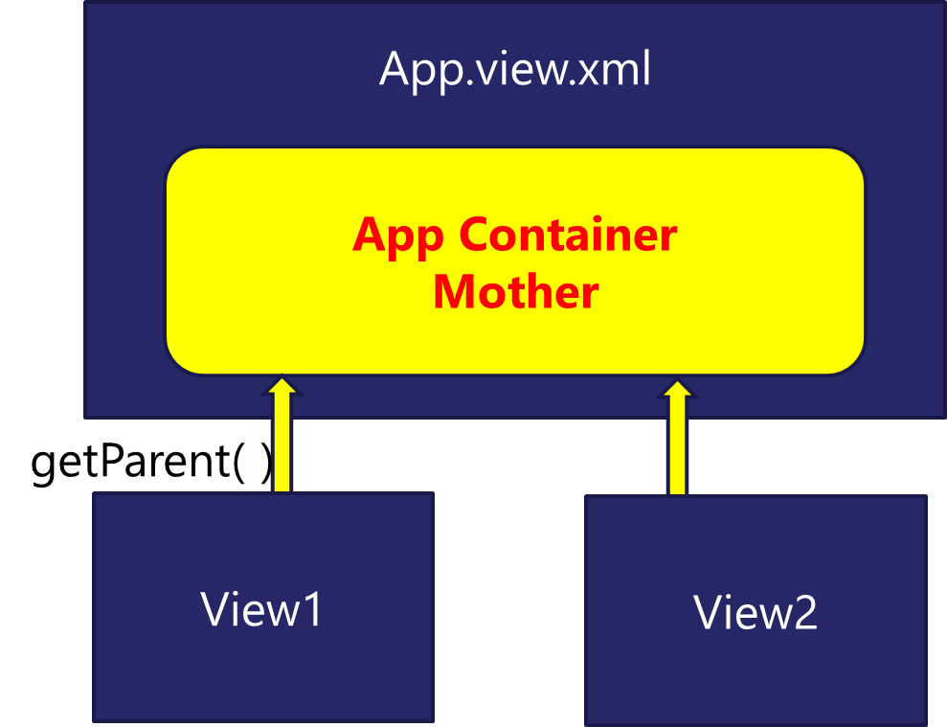
App Container
Most of the Fiori app developed in the industry used to have more than one view. To work with multiple views, we use the concept of Parent View in the Fiori application. Which means all the views are loaded in one Parent View(App View) which then calls the view we want to display to the user.
The App view will behave as a container for other views.

Slide 23
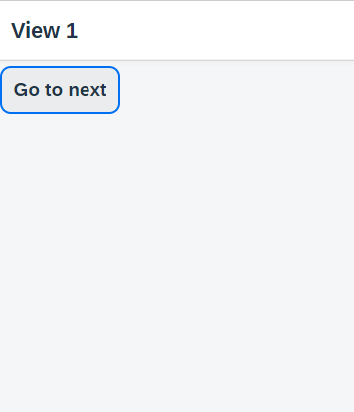
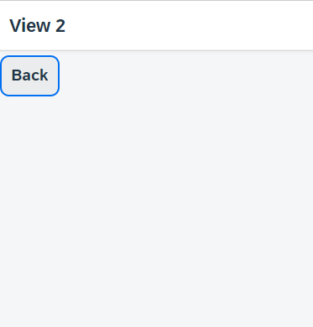
Hands – on: Working with multiple views
Now to understand how the app container works we will add two new views (View1 and View2).
Similarly we have to create a View1 controller and View2 controller.
Since we are using multiple controllers we should also create a Base Controller to inherit the controller class at one place.
Once these files are created, copy the code from below links.
For this exercise we will create a Button on both View1 and View2. On press of that buttons we will navigate to the another view. View1 to View2 and vice-versa.
Code Links:
App.view.xml
App.controller.js
View1.view.xml
View1.controller.js
View2.view.xml
View2.controller.js
BaseController.js
Component.js

Slide 24
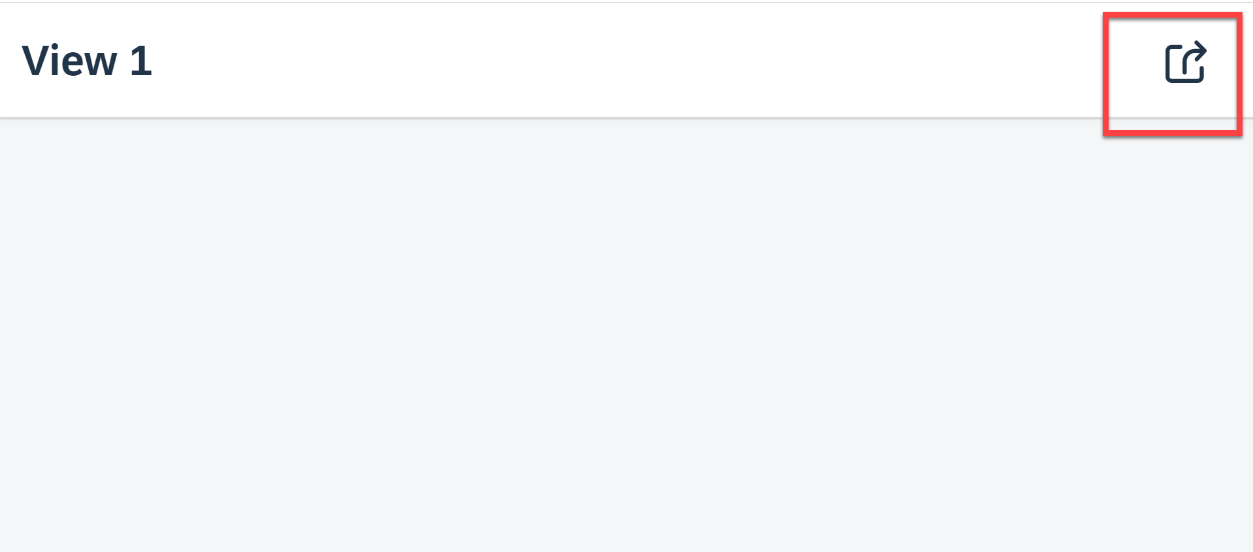
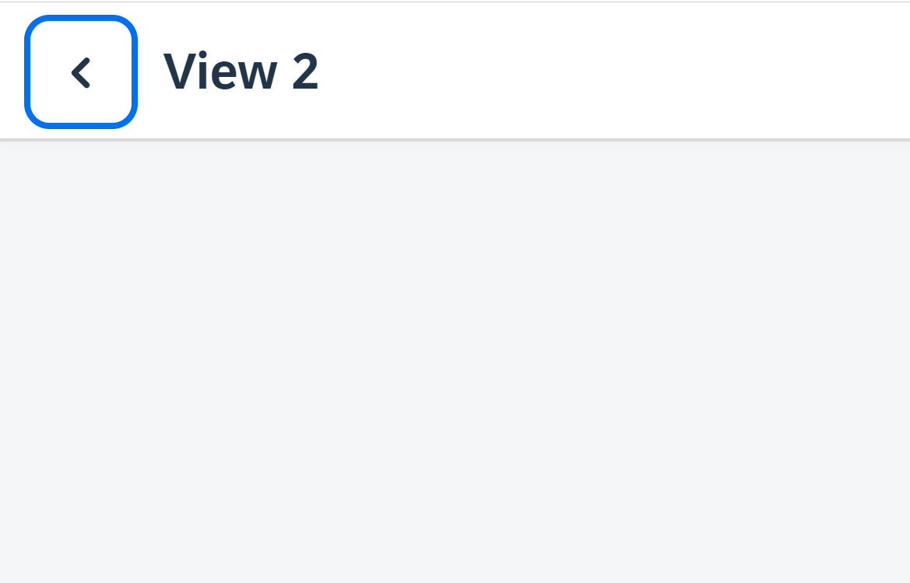
Hands – on: Header Navigation Buttons
As we see in most of the application the Navigation button are place inside the navigation bar at the top.
So we, will move the button to the Nav bar using the headerContent aggregation of the sap.m.Page control.
The standard page control also provides a some properties to add the Nav button without using the custom control.
Code Links:
View1.view.xml
View2.view.xml

Slide 25
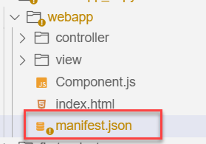
Manifest.json file
manifest.json is also knows as application descriptor file. When someone look at my application, my application descriptor will express all the necessary properties.
It contains all the configuration for our application.
manifest.json is a file which contains all the properties and initialization of our app. When app starts SAPUI5 framework will read this file and generate necessary artefacts out-of-box for us.
It is written in JavaScript Object Notation (JSON) format.
Reasons why we need manifest:
Once upon a time, I was in goa and enjoying my drink on beach, suddenly my phone rings and guess who is on the other side? You have developed a Fiori app last week and left for vacation, today we have a customer ticket and I am sitting with one your colleague, unable to understand what you did? Can you come and connect for some time.
A team member is leaving our team, he/she has developed 20 Fiori apps and now you suppose to take handover, she/he is not cooperating because they leaving, how will you hold on to the code?
SAP Delivers 1000s Fiori apps but they don’t send mobile no. of Labs developer. How will we understand where and what app is doing?
Documentation for manifest.json file: https://sapui5.hana.ondemand.com/#/topic/be0cf40f61184b358b5faedaec98b2da

Slide 26
Section of manifest.json
sap.app contains id, type, i18n, applicationVersion, title, description, dataSources.
sap.app
sap.ui contains technology, icons, deviceTypes, supportedThemes
sap.ui
sap.ui5 contains different components
rootView, dependencies, contentDensities, models, routing etc.
sap.ui5

Slide 27
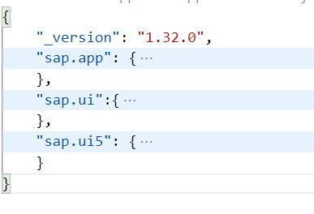
Hands – on: Create the manifest.json file
Now we will create the manifest.json file in our webapp folder.
Along with that we have to create the i18n folder and in that folder a i18n.properties file.
Then we have to add the required code to these file.
Also link the manifest to the Component.js file.
Code Links:
manifest.json
i18n.properties
Component.js

Slide 28
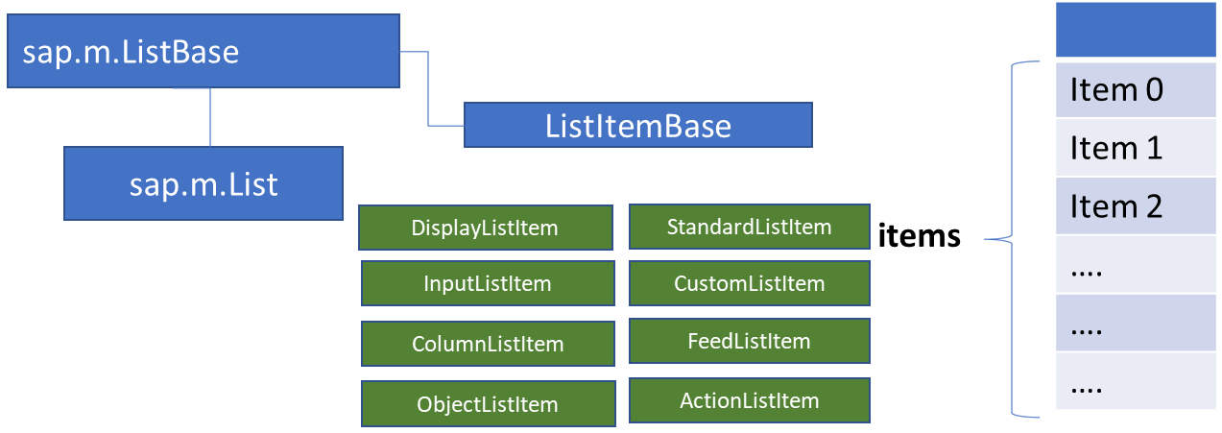
List Control
The list contains various list items. These items can be of various types depending on the use case and on the content they have. SAPUI5 already provides the most common list items in SAP Fiori in the form of controls, although custom list items can also be created if necessary.
Reference: https://sapui5.hana.ondemand.com/#/entity/sap.m.List
A List control is a single column table with multiple items inside. We will have a list header and items as aggregation.

Slide 29
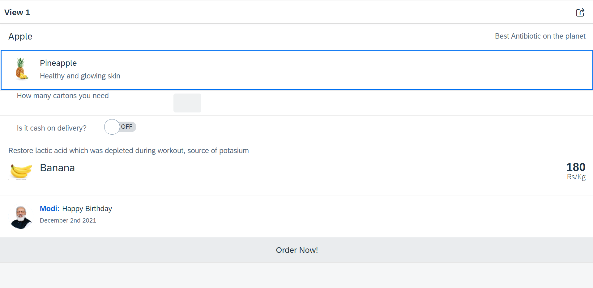
Hands – on: List Controls in UI5
Now we will add some basics list controls in the View1 of our application.
Code Links:
View1.view.xml

Slide 30
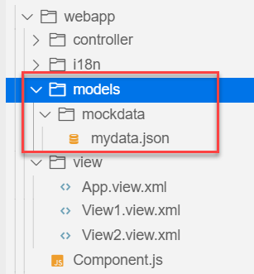
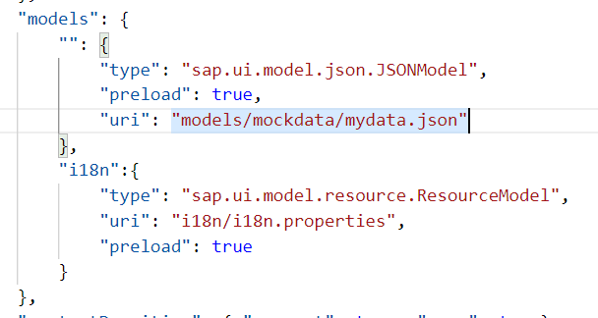
Hands – on: Models in manifest.json
Now we want to bind our list control to a model to show the multiple records using the list control.
For this first we need a file with some demo data related to the fruits, so we have created a file which has three entity sets:
fruits – name, color, type (neutral, citrus, alkaline),price, healthBenefit, unit, status (available, discontinued, out of stock), image (url from google) – 20
cities – name, state, famousFor, population – 10
supplier – name, city, country, contactPerson, phone, email, sinceWhen – 10
Now we will create a models folder in the webapp and in the models folder we will create a folder named mockdata, we will put our json file in this folder.
Code Link:
manifest.json
mydata.json
View1.view.xml

Slide 31
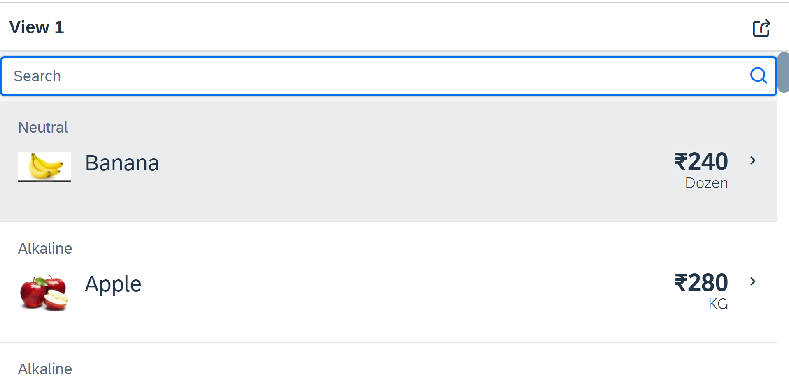
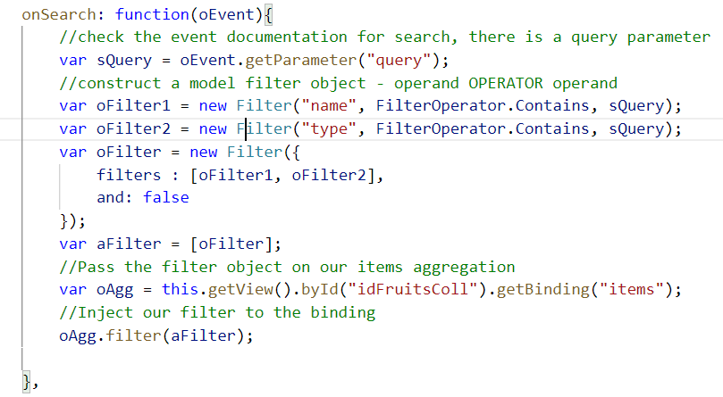
Hands – on: Search Functionality
Nowadays we come across many web pages that provide data in the form of lists or tables. These lists are enabled with search functionality, i.e., as the user types in into the search field and press enter then the data in the list is filtered according to the value in search field.
Code Link:
View1.view.xml
View1.controller.js

Slide 32
List Modes
The mode property defines the appearance of the left area of a list item.
Lists have properties and events and they contain list items that inherit from sap.m.ListItemBase, which provides navigation, selection and event features.
Delete
SingleSelect
01
04
only one list item can be deleted via provided delete button
Right-positioned single selection mode (only one list item can be selected).
01
04
MultiSelect
You can edit this text
SingleSelectLeft
02
05
02
more than one list item can be selected
05
Left-positioned single selection mode (only one list item can be selected).
03
06
None
03
06
SingleSelectMaster
no selection
Selected item is highlighted but no selection control is visible (only one list item can be selected).

Slide 33
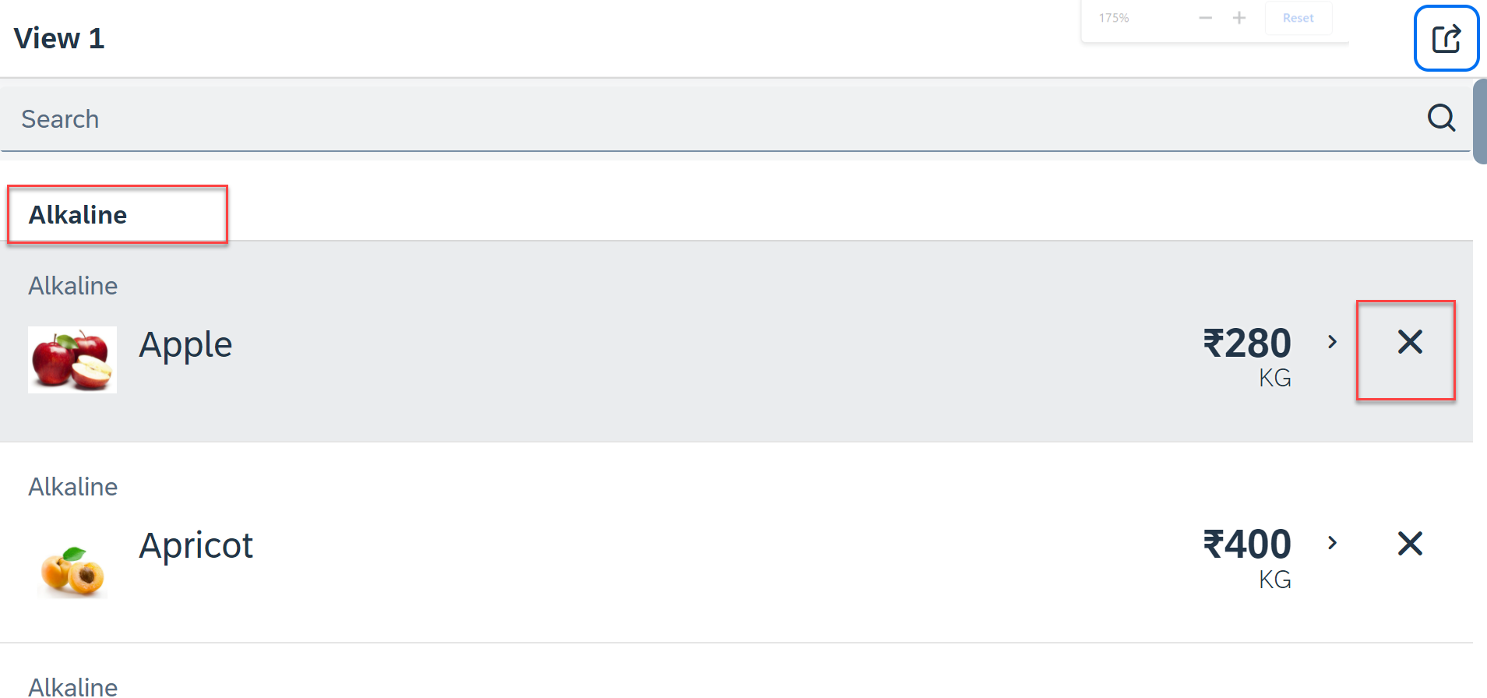
Hands – on: List modes and Grouping
Now we will look at the different type of List mode provided by the UI5.
Along with that we will Implement the Press event, Selection change and Delete Event in the List Control.
Also we will Group the data according to the type of Fruit.
Code Link:
View1.view.xml
View1.controller.js

Slide 34
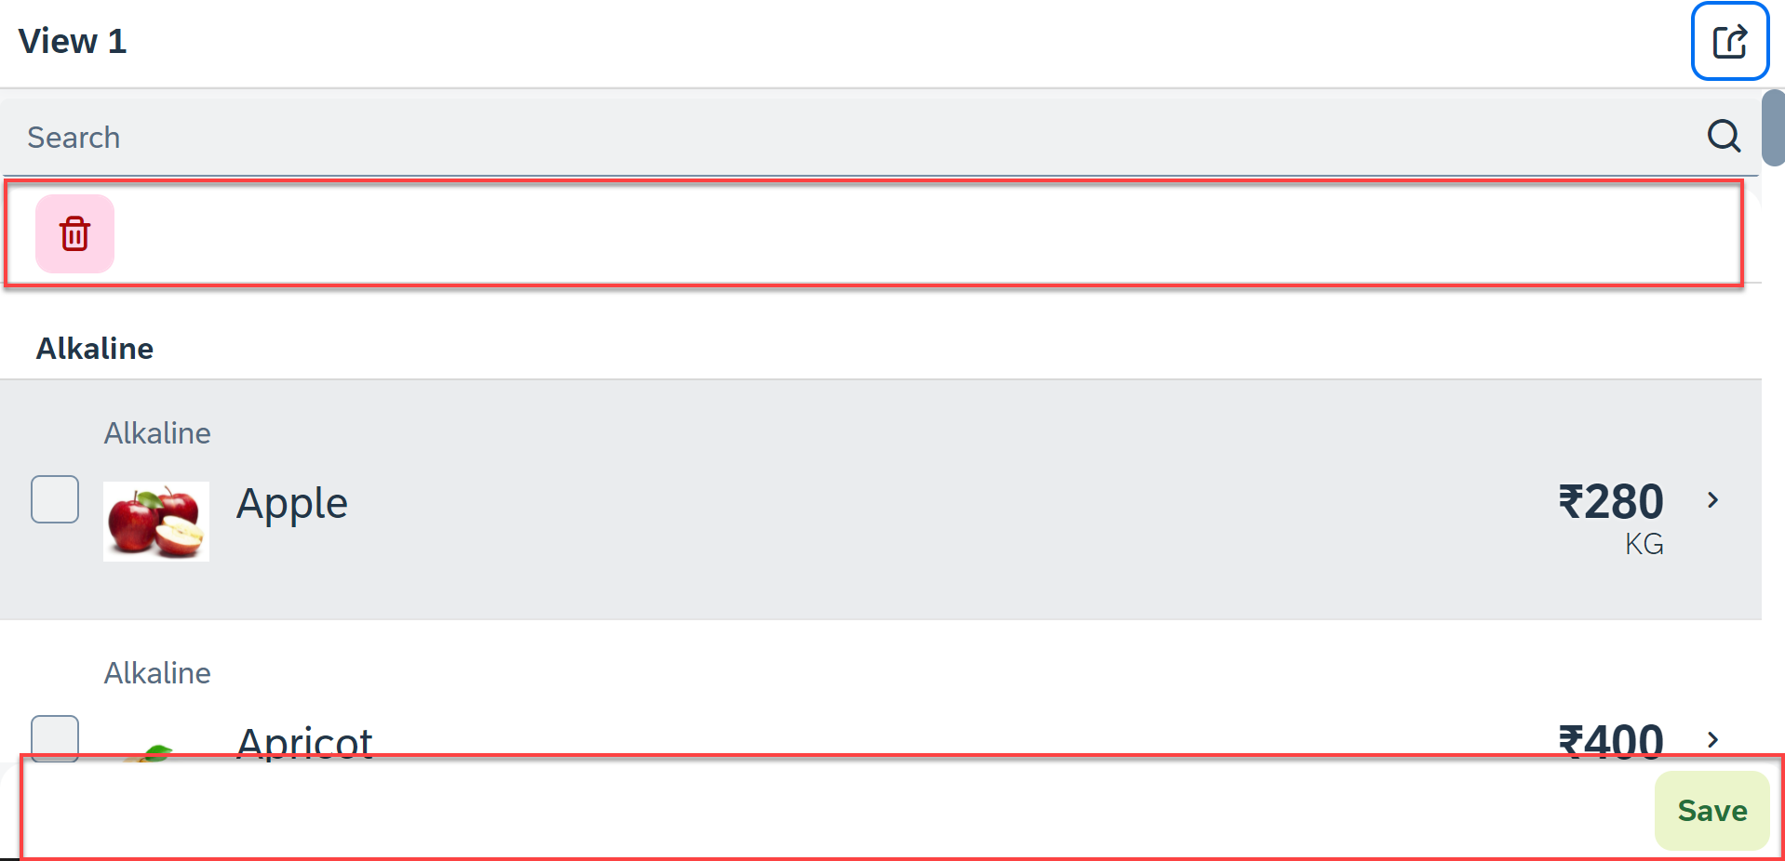
Hands – on: Header and Footer Toolbar
Now we will add a Header Toolbar to the list control and in that we will add a delete button to delete multiple items from the List.
We will also add a Footer toolbar to the page control and in that we will add a save button on press of the save button a alert will be shown to the user.
Code Link:
View1.view.xml
View1.controller.js

Slide 35
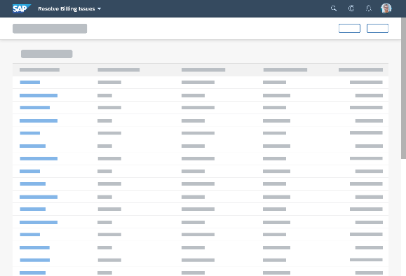
Introduction to Worklist Application
A worklist displays a collection of items a user needs to process. Working through the list usually involves reviewing details of the items and taking action. In most cases, the user has to either complete a work item or delegate it.
When to use:
Users have numerous work items and need to decide which ones to process first.
You want to give users a direct entry point for taking action on work items.
Users need to work with multiple views of the same content (for example, items that are “Open”, “In Process”, or “Completed”). You want to offer tabs for switching between views.
Detail View
List Page

Slide 36
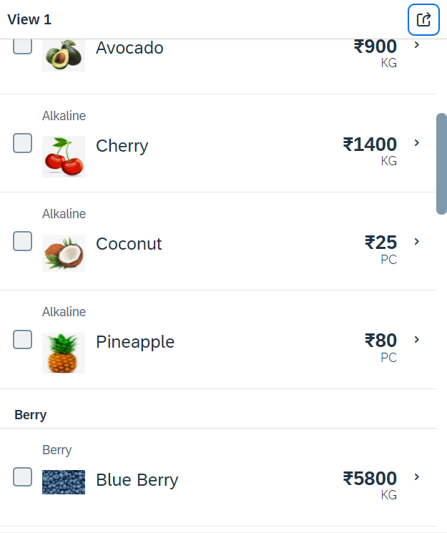
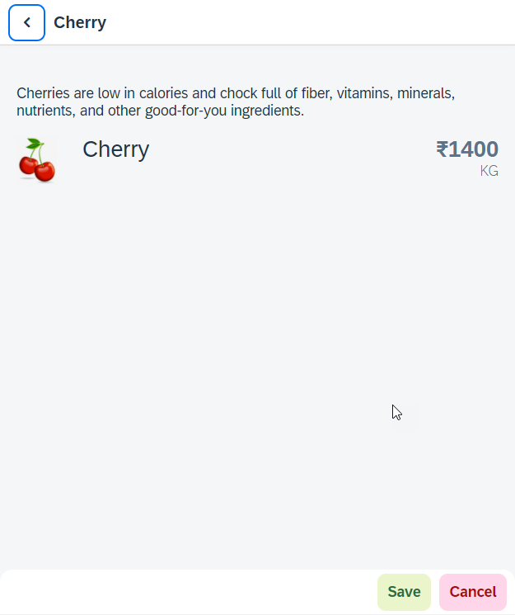
Hands – on: Worklist App
Now we will make our application a worklist app. On selecting the fruit on the View1 navigate to the View2 and show the details of that the selected fruit on it.
For this we have to modify the onSelectItem Function to get the path of the selected item and pass it in the onNext function.
Code Link:
View1.view.xml
View1.controller.js
View2.view.xml

Slide 37
SplitApp Container Control
A split app container control will divide our app into 2 parts, 1st is called master section and 2nd is called detail section. It is used to fully optimize the screen width for desktop apps.
SplitApp Container
masterPages
detailPages
App Container
View1
View2
View1
View2

Slide 38
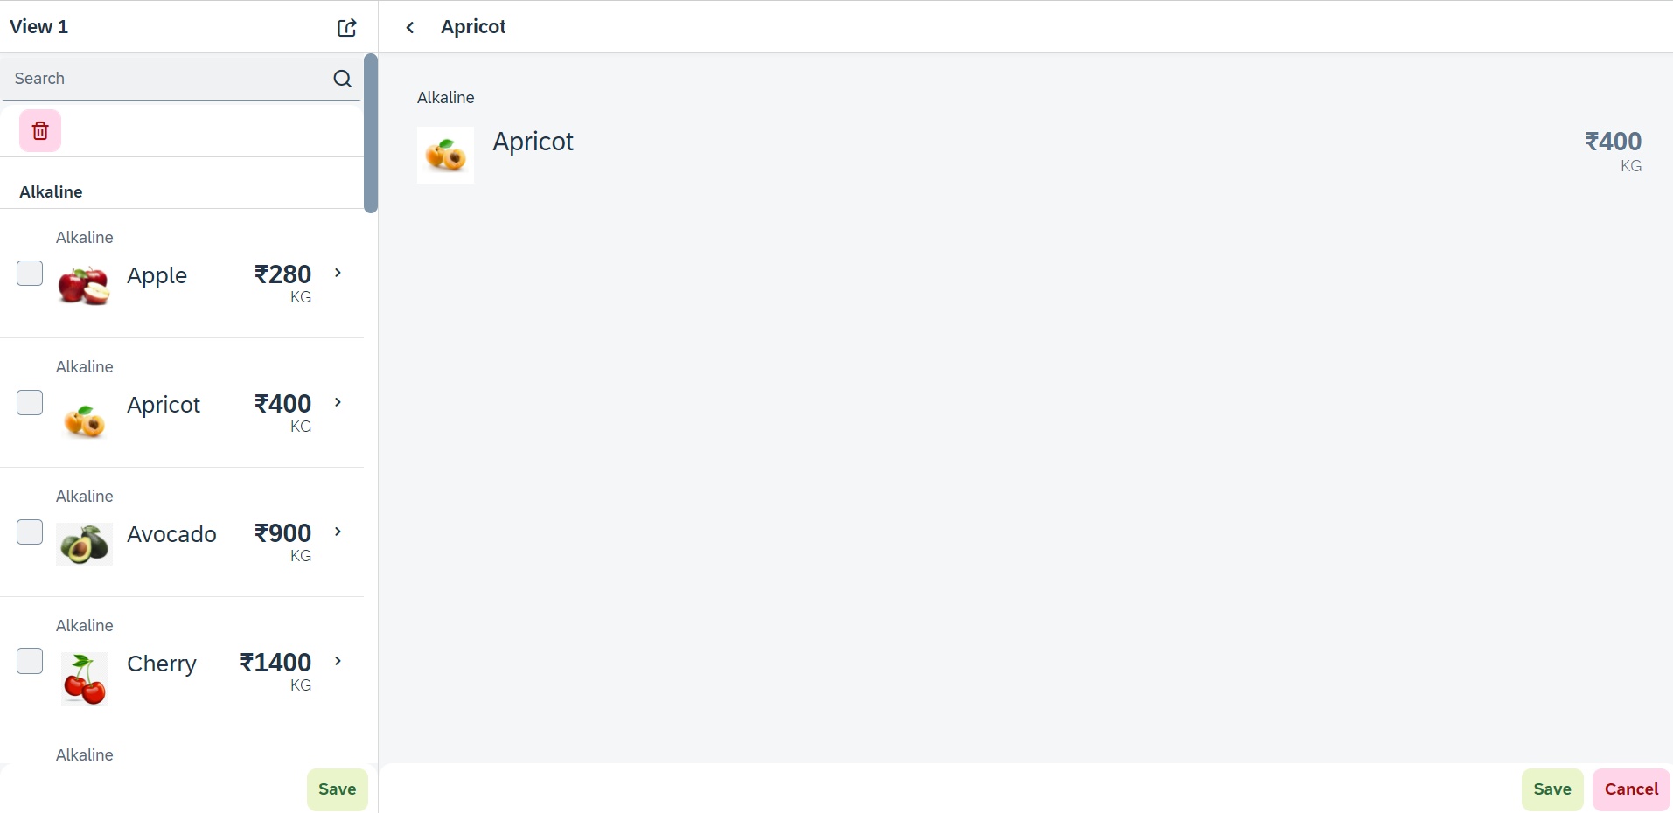
Hands – on: SplitApp (Mater Detail App)
Now we will convert our worklist app to a master detail application.
Once we change the app container, we have to change the method of getting the view object in onNext function.
Code Links:
App.view.xml
Component.js
View1.controller.js

Slide 39
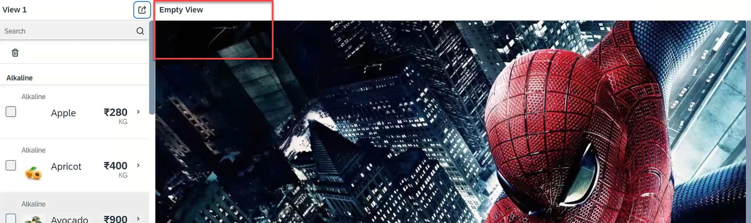
Hands – on: Empty View at start
Now we want to load an Empty view in the detail section when our application starts.
To do this first we need to create one Empty View and Empty controller.
After we need to add the Empty view to the Split App container in the Component.js file.
oAppCon.addMasterPage(oView1).addDetailPage(oEmpty).addDetailPage(oView2);
Code Link:
Empty.view.xml
Empty.controller.js
Component.js
View1.controller.js
This view will be loaded by default

Slide 40

Performance Issues in our Fiori App
We have used sap.ui.view API to create the object of the view, but it seems that the API is obsolete. Then what is the right way to instantiate our view?
All the view objects are instantiated when app starts, whether we want or not. If user does not navigate to a view, still the view object is getting created. This is a misuse of computation power and slow down our app when number of views are increased/high.
For each view, we are writing more and more code to create object, multiple developers will add this code in different place, because of this the maintenance will be come very expensive even the handover will be very hard.
The browser navigation button (back) is not working properly.
When the refresh of app happens, the application should restore the state of the UI. It should not start all over again. So user will not frustrate applying all the filters again.
When we take a URL of the page and share with colleagues/friends/family, when they open same URL, Eventually they should see the same state of application what I see. Basically we should restore the state of UI as it is in our system.
Router

Slide 41

End of Day 7

Slide 42

Questions

Slide 43

Shekhar Vedi

Slide 44


We’re committed to empower you to be
Most Desirable Resource
through powerful training solutions.
We build the workforce of the future.
250+
Corporate Clients
30,000+
Learners Trained
25000+
Learners Placed
FREE WEBINARS
Sign up for free webinars with industry experts every fortnight!
Enroll Now!
Contact us today!
https://anubhavtrainings.com/

Slide 45




More from AnubhavTrainings.com

Slide 46
Title
Content

